Slide 1
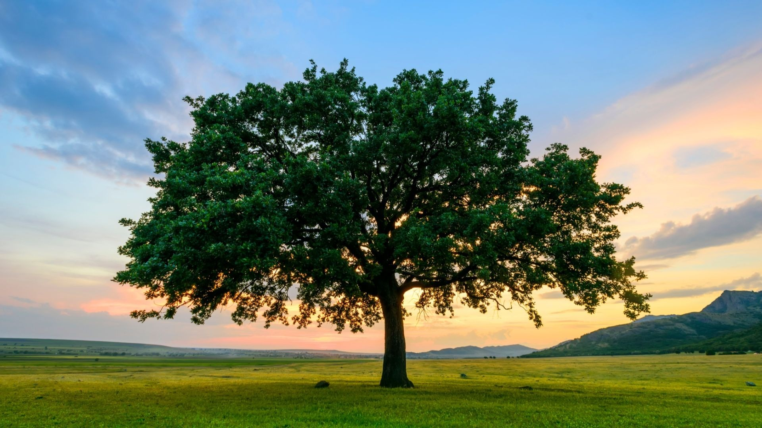
How Do I Grow Mature
as a Believer in Jesus Christ?
Part 2 of 2
Preached by Dr. Jim Harmeling at Crossroads International Church Singapore • CICFamily.com Uploaded by Dr. Rick Griffith • Singapore Bible College Files in many languages for free download at BibleStudyDownloads.org

Slide 2
How Do I Grow Mature as a Believer in Jesus Christ?

Slide 3
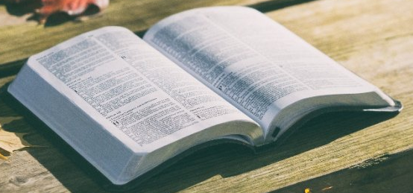
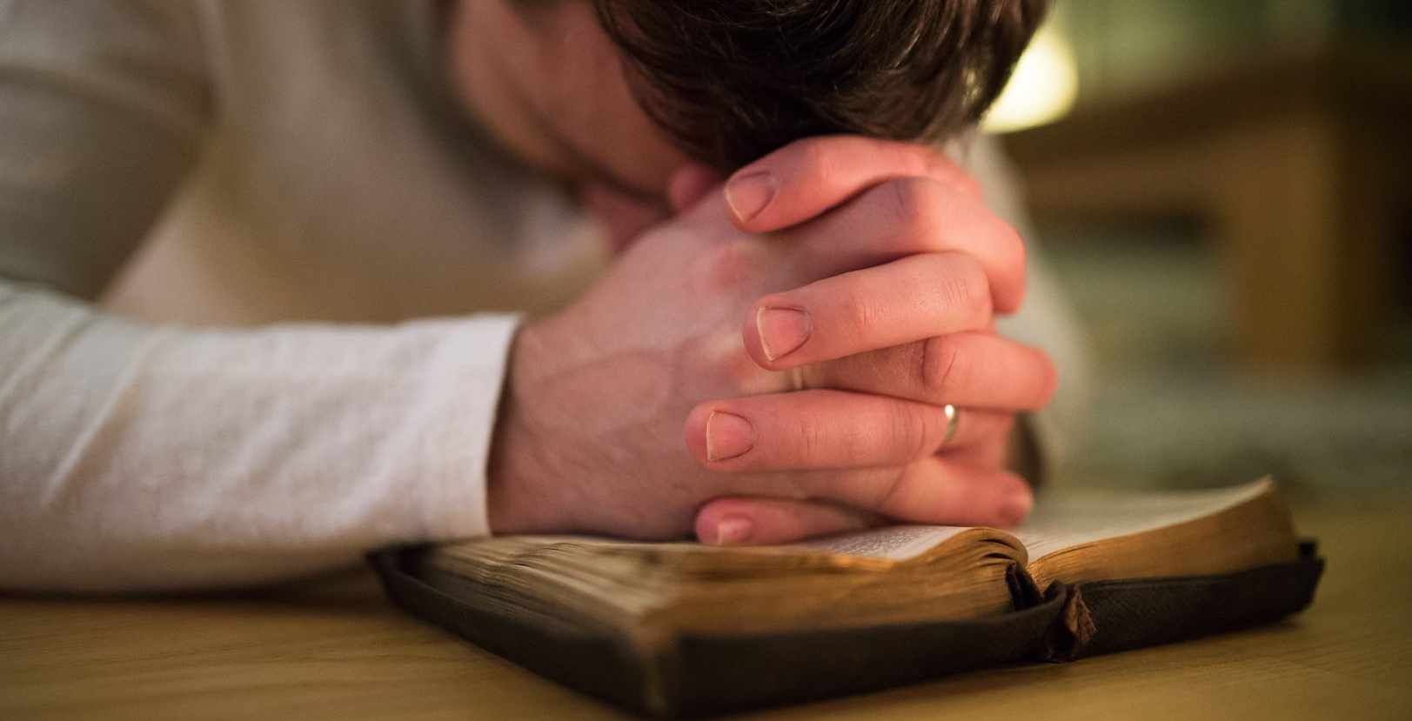
Primary Means of Spiritual Growth
Bible
Prayer

Slide 4
Ask the root question
How do I glorify God with my life?

Slide 5
Grow in the knowledge and application of God’s Word

Slide 6
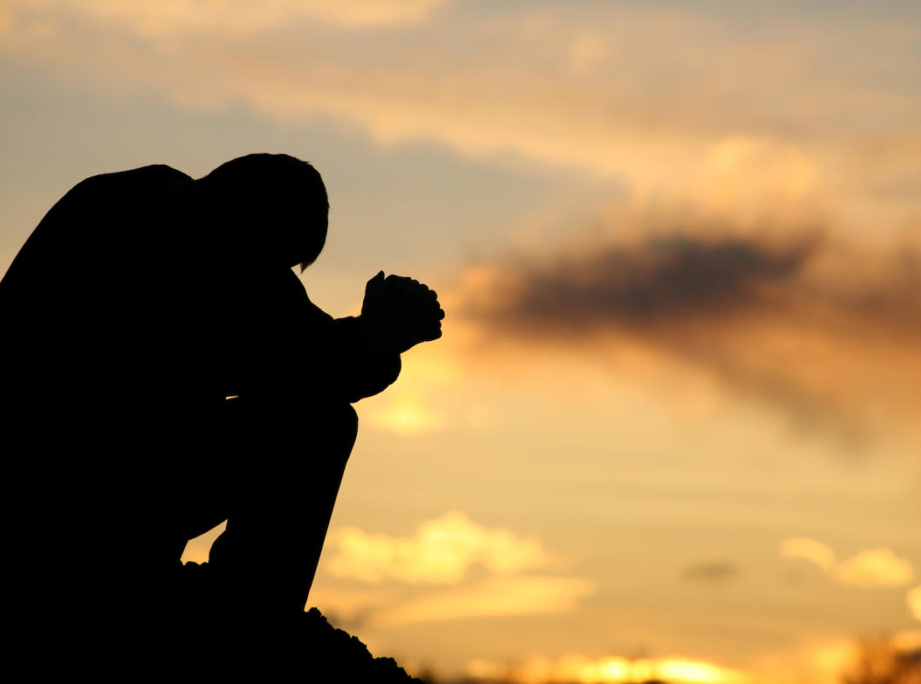
Develop the Practice of Prayer

Slide 7
1 Timothy 6:15-16
¹⁵ . . . he who is the blessed and only Sovereign, the King of kings and Lord of lords, ¹⁶ who alone has immortality, who dwells in unapproachable light, whom no one has ever seen or can see. To him be honor and eternal dominion. Amen.

Slide 8
Matthew 11:28
Come to me, all who labor and are heavy laden, and I will give you rest.
Hebrews 4:15-16
¹⁵ For we do not have a high priest who is unable to sympathize with our weaknesses, but one who in every respect has been tempted as we are, yet without sin. ¹⁶ Let us then with confidence draw near to the throne of grace, that we may receive mercy and find grace to help in time of need.

Slide 9
Romans 8:34, 26-27, 15

Slide 10
Acts 2:42
And they devoted themselves to the apostles' teaching and the fellowship, to the breaking of bread and the prayers.
Colossians 4:2-4
² Continue steadfastly in prayer, being watchful in it with thanksgiving. ³ At the same time, pray also for us, that God may open to us a door for the word, to declare the mystery of Christ, on account of which I am in prison— ⁴ that I may make it clear, which is how I ought to speak.

Slide 11
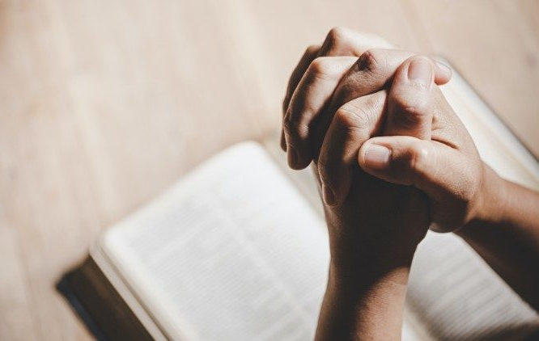
God’s compassion: Humble admission of need
Why Pray?

Slide 12
Matthew 7:7-11
⁷ Ask, and it will be given to you; seek, and you will find; knock, and it will be opened to you. ⁸ For everyone who asks receives, and the one who seeks finds, and to the one who knocks it will be opened. ⁹ Or which one of you, if his son asks him for bread, will give him a stone? ¹⁰ Or if he asks for a fish, will give him a serpent? ¹¹ If you then, who are evil, know how to give good gifts to your children, how much more will your Father who is in heaven give good things to those who ask him!

Slide 13
God’s compassion: Humble admission of need
God’s power: Bold request for change
Why Pray?

Slide 14
James 5:16-18
¹⁶ The prayer of a righteous person has great power as it is working. ¹⁷ Elijah was a man with a nature like ours, and he prayed fervently that it might not rain, and for three years and six months it did not rain on the earth. ¹⁸ Then he prayed again, and heaven gave rain, and the earth bore its fruit.

Slide 15
Luke 18:1-8
And he told them a parable to the effect that they ought always to pray and not lose heart. ² He said, “In a certain city there was a judge who neither feared God nor respected man. ³ And there was a widow in that city who kept coming to him and saying, ‘Give me justice against my adversary.’ ⁴ For a while he refused, but afterward he said to himself, ‘Though I neither fear God nor respect man, ⁵ yet because this widow keeps bothering me, I will give her justice, so that she will not beat me down by her continual coming.’” ⁶ And the Lord said, “Hear what the unrighteous judge says. ⁷ And will not God give justice to his elect, who cry to him day and night? Will he delay long over them?

Slide 16
Luke 18:1-8
⁸ I tell you, he will give justice to them speedily. Nevertheless, when the Son of Man comes, will he find faith on earth?

Slide 17
God’s compassion: Humble admission of need
God’s power: Bold request for change
God’s wisdom: Anxious desire for resolution & peace
James 1:5
If any of you lacks wisdom, let him ask God, who gives generously to all without reproach, and it will be given him.
Why Pray?

Slide 18
God’s compassion: Humble admission of need
God’s power: Bold request for change
God’s wisdom: Anxious desire for resolution & peace
God’s holiness: Concern over progress of sin
Why Pray?

Slide 19
Psalm 109:1-4
¹ Be not silent, O God of my praise! ² For wicked and deceitful mouths are opened against me, speaking against me with lying tongues. ³ They encircle me with words of hate, and attack me without cause. ⁴ In return for my love they accuse me, but I give myself to prayer.

Slide 20
The Lord’s Prayer
How Do I Pray?

Slide 21
Praise God’s name
Our Father in heaven, hallowed be your name.
Submit our will to His
Your kingdom come, your will be done, on earth as it is in heaven.
Ask for Provision
Give us this day our daily bread
Ask for Forgiveness
and forgive us our debts, as we also have forgiven our debtors.
Ask for Guidance & Protection
And lead us not into temptation, but deliver us from evil.
Praise God’s name
For Thine is the kingdom, and the power, and the glory, forever and ever. Amen

Slide 22
The Lord’s Prayer
The Lord’s Example
How Do I Pray?

Slide 23
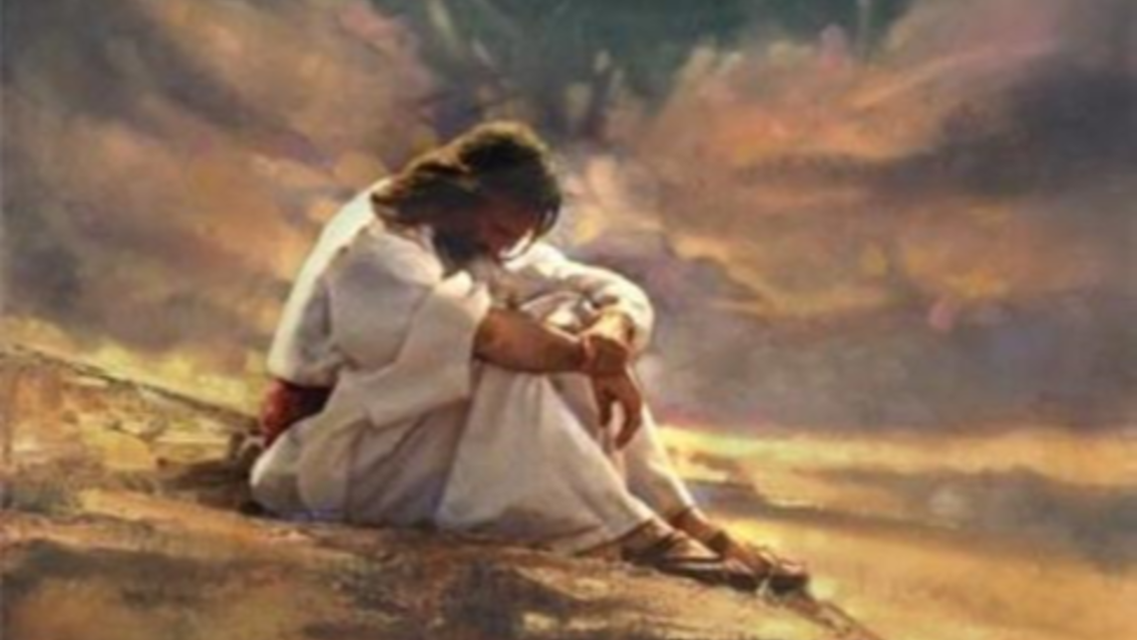
(6:12; 9:28) “mountain”
(5:16) “desolate places”
(9:18) “alone”
(11:1) “certain place”
(22:39-46) Mount of Olives “as was his custom”
(6:12-13) whole night
(22:31-32) praying for Peter
(23:46) dying on the cross
(24:30-31) blessing bread after resurrection
Luke’s record of Jesus praying

Slide 24
Let’s Put This Together
+
=
ESV app
Echo app

Slide 25
Black

Slide 26
Topical Preaching link at BibleStudyDownloads.org
Get this presentation for free!
Notes:
The Bible…Basically (bb)

